Slide 1
Lab 1: Project plan Setup workspace
Vu Tuan Hai

Slide 2
Week | Topic | Homework
1 | Overview about the workspace of a software engineer | Project plan Setup workspace
2 | Analysis | Usecase diagram Sequence diagram
3 | Design | Class diagram Database diagram UI / UX prototype
4 | Implement | N/A (coding)
5 | Testing | N/A (coding)
6 | Evaluation the project | Complete project

Slide 3

Workspace
A workspace is the surrounding space when you need to do something. The bedroom is an example. It has a bed, timetable, laptop, … Each thing takes a role when you get into the room.

Slide 4
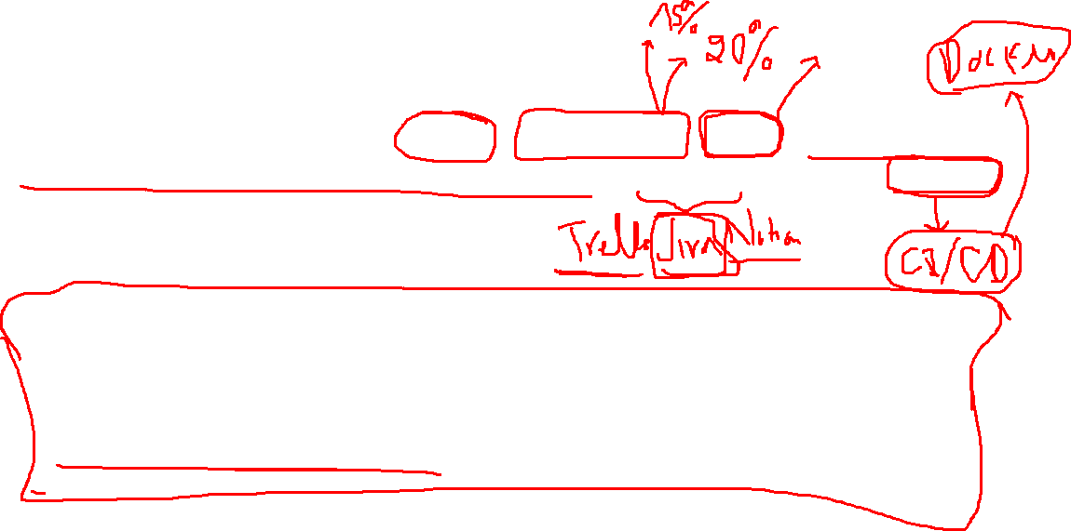
Workspace in the software engineering process – CASE tool
It’s a collection of tools that are used in different phases (take requirements – analysis – design – implement – test – maintain) and different aspects of software engineering (manage – assign – deploy - …).
Note that in this practice class, these tools are used as illustrations. Deeper knowledge will be in other courses. Ex:
- Information Systems Project Management: MSIS 3033
- System Analysis and Design: MSIS 3303
…

Slide 5

CASE tool
Enviroment
Upper CASE
Planning
Analysis
Design
Workbench 1
Workbench 2
Integrated CASE tool
Lower CASE
Implement
Test
Tool 1
Tool 2
Tool 3
Maintain

Slide 6
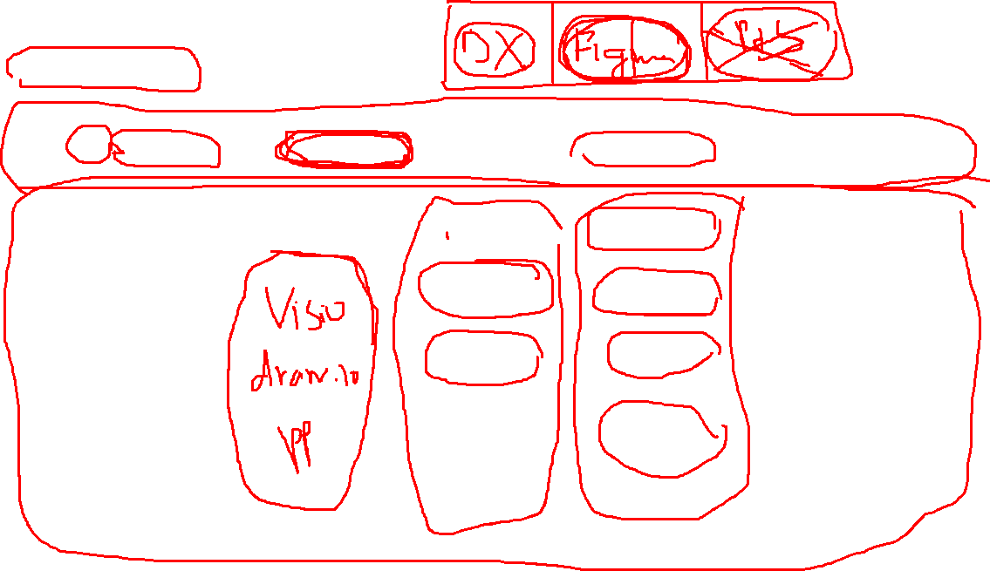
Project management
Task: Trello / Jira
Source code: Git / Github
Other materials: Git / Drivers
Take requirements
Analysis
Design
Implement
Test / Maintain
Diagram
Framework
UI / UX
IDE
Figma
Other package

Slide 7

Setup project management
Follow link: https://trello.com/b/N0dTGGkV/sample-project-plan

Slide 9
Setup sources control
Install Git / Github
Follow link: https://github.com/vutuanhai237/Sample-Project-CS4273
Leader clones this repository and add members into it.
Rename the repository.
Each member needs to fetch source code to local machine, create their own branch – switch branch and contribute to the repository.

Slide 10
Homework
Choose your group, vote a leader and a topic.
Setup environment as instructions.
Update environment (Github repository link) in Files/Group Information.
Deadline: 2 weeks.

Slide 11
Question

